Slide 1
Retail Sales Performance Analysis Report
July 2026
Executive Summary
This dashboard analyzes product sales performance using quantity sold and purchase frequency across 394 products. The analysis identifies top-performing products, category contribution, and customer purchase patterns.

Slide 2
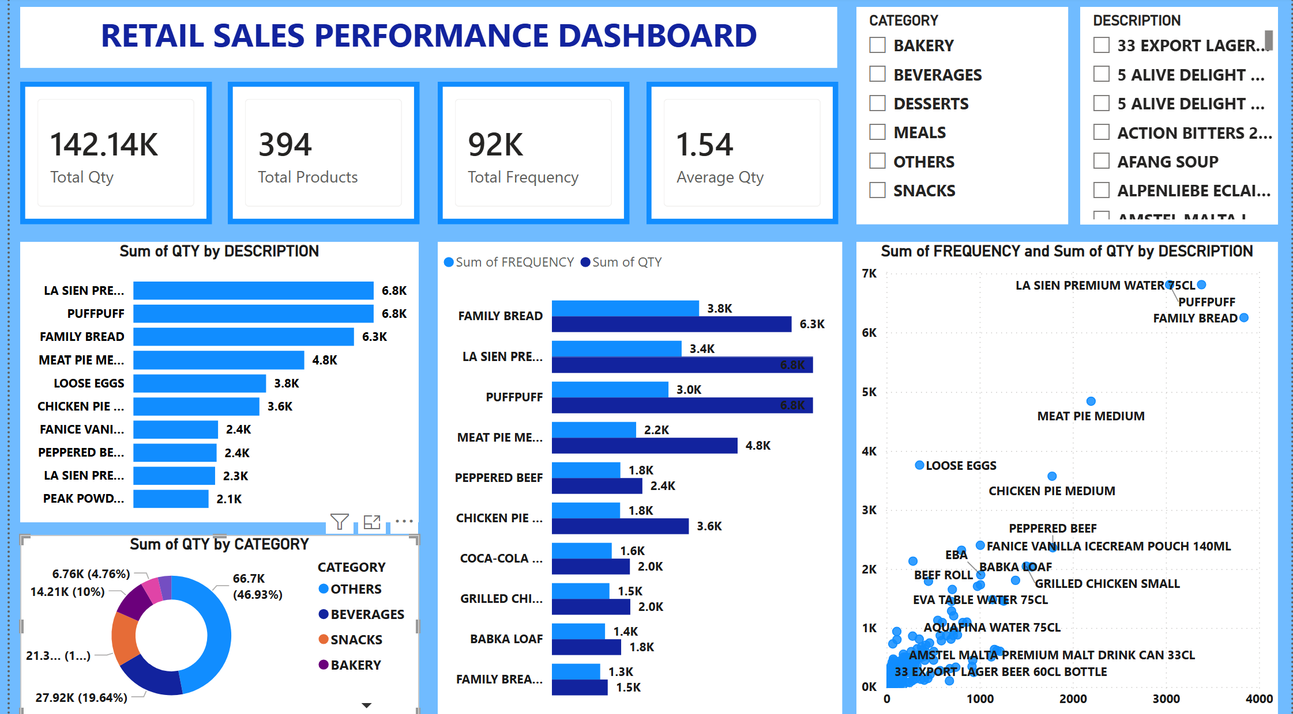
Report Overview- Dashboard

Slide 3
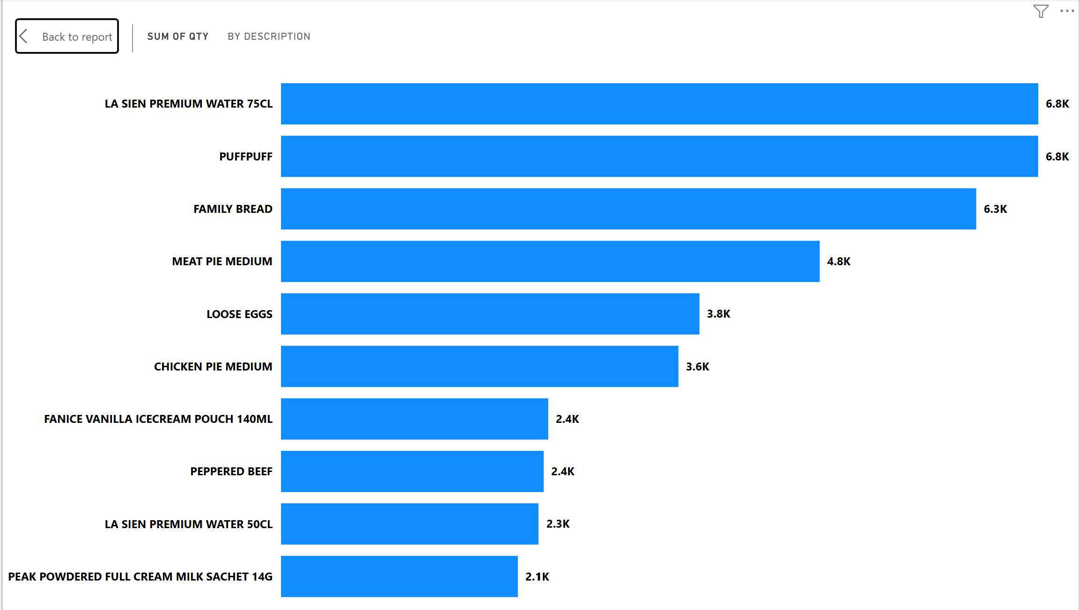
Top Products by Quantity
Key Insights
La Sien Premium Water 75CL recorded the highest quantity sold (6.8K units).
Puffpuff and Family Bread are also among the strongest-selling products.
Bakery and beverage products dominate overall sales volume.

Slide 4
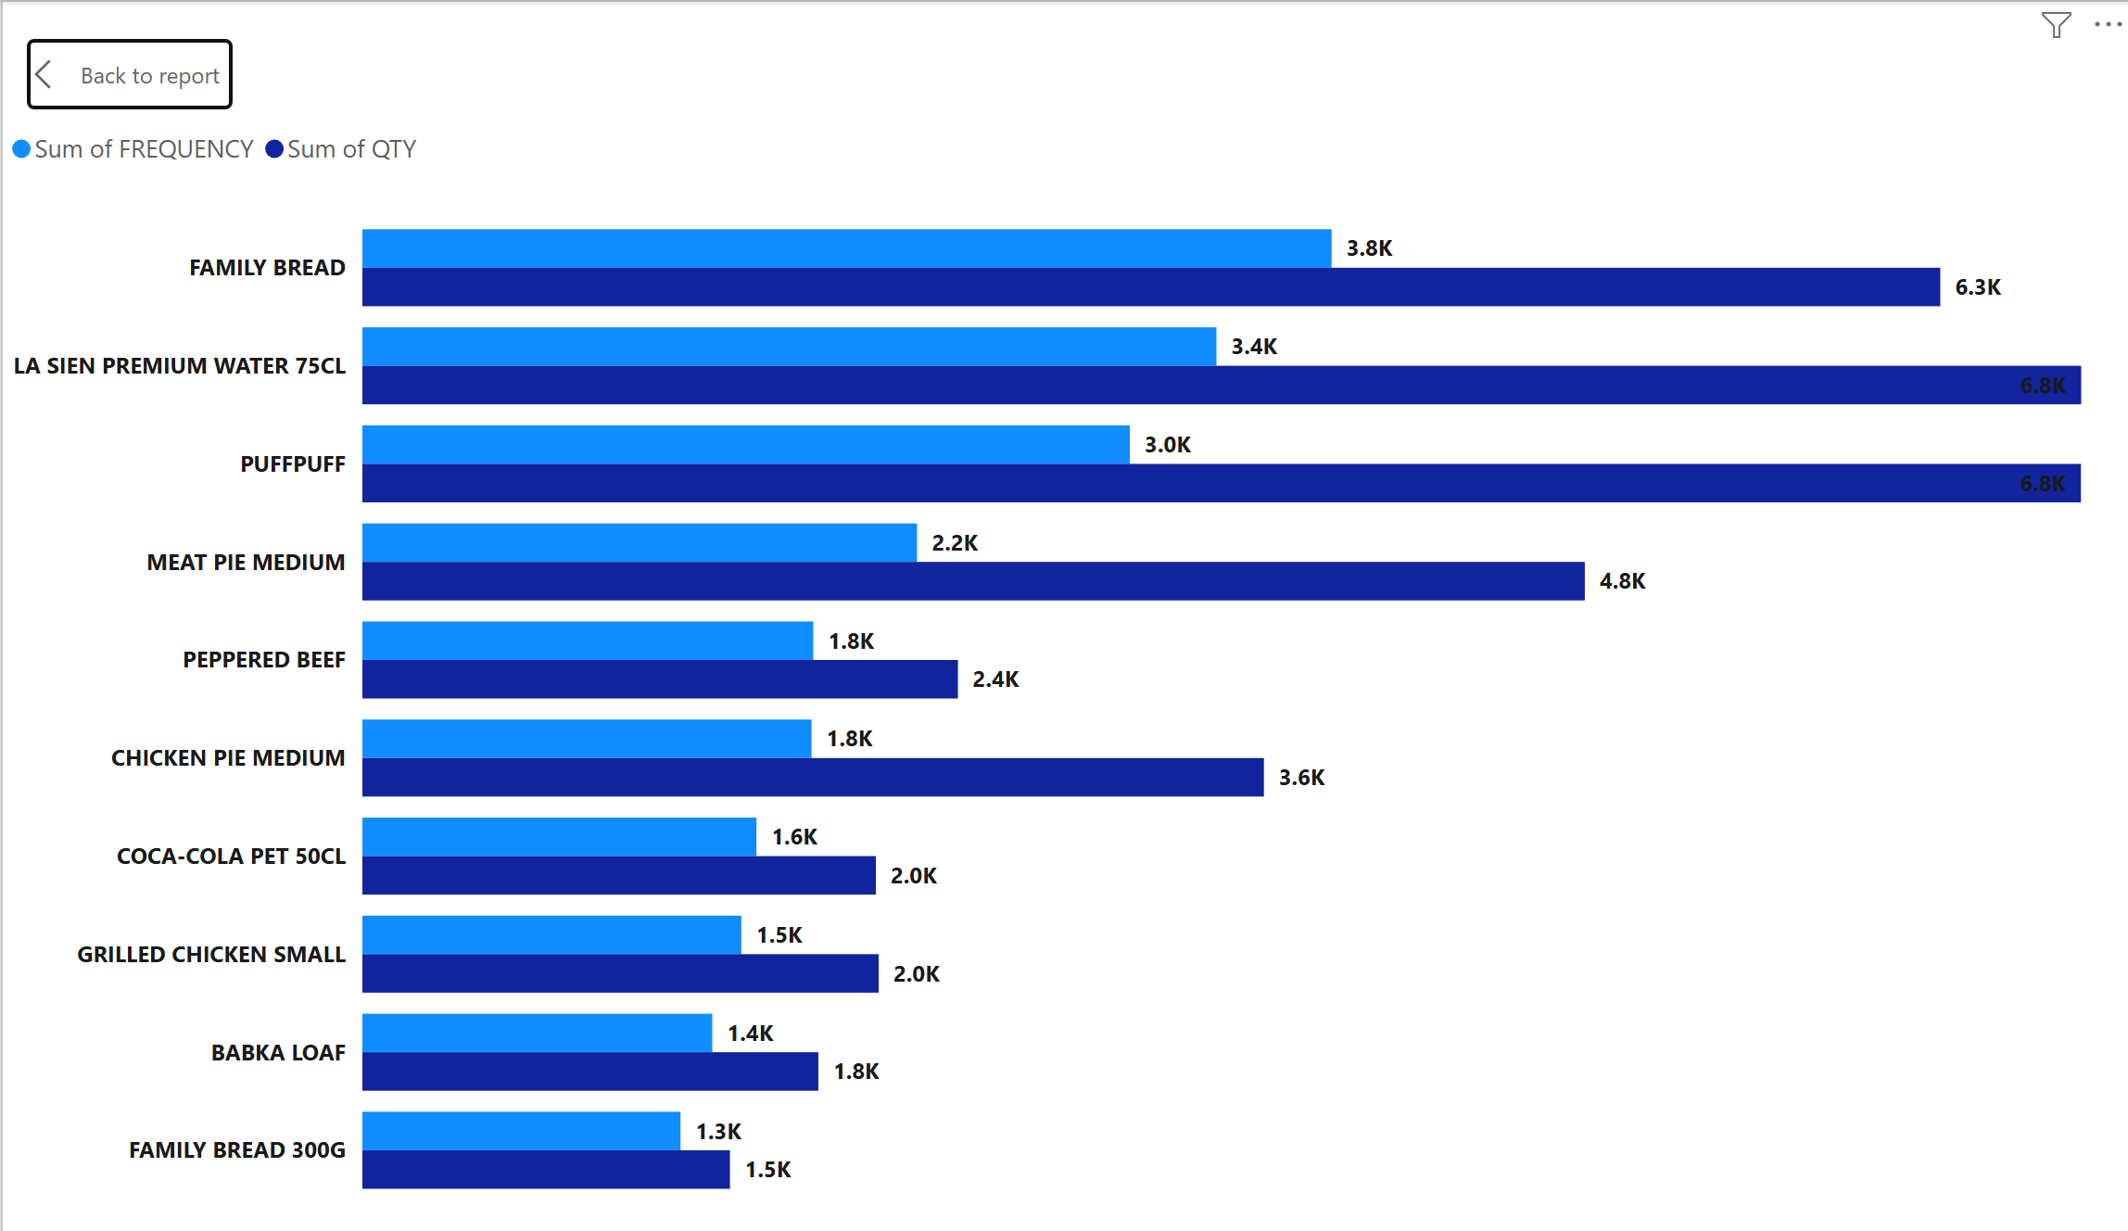
⁠Top Products by Frequency
Key Insights
Family Bread was purchased most frequently (3,839 times).
Water products appear repeatedly among top-performing items, showing strong customer demand.
Essential everyday products generate more repeat purchases.

Slide 5
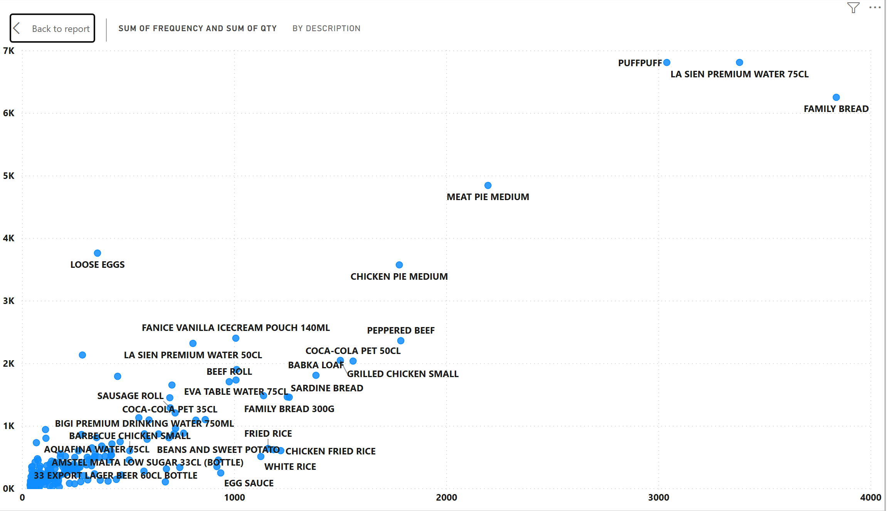
Frequency vs Quantity Analysis
Key Insights
Family Bread and La Sien Premium Water 75CL are high-frequency, high-volume products, making them star products.
Some products have high quantities but lower purchase frequency, indicating bulk purchases.
Products in the lower-left quadrant show weak performance and may require promotion or review.

Slide 6
Recommendations
Based on my detailed analysis of the retail sales performance , my recommendations are presented below:
1
Maintain adequate stock levels for Family Bread and La Sien Premium Water products.
2
Increase marketing efforts for low-performing products.
3
Review products with low frequency and low quantity for possible replacement or promotional campaigns.
4
Expand high-performing beverage and bakery product lines.

Slide 7


7

